Slide 1
MapReduce High-Level Languages
WPI, Mohamed Eltabakh

Slide 2
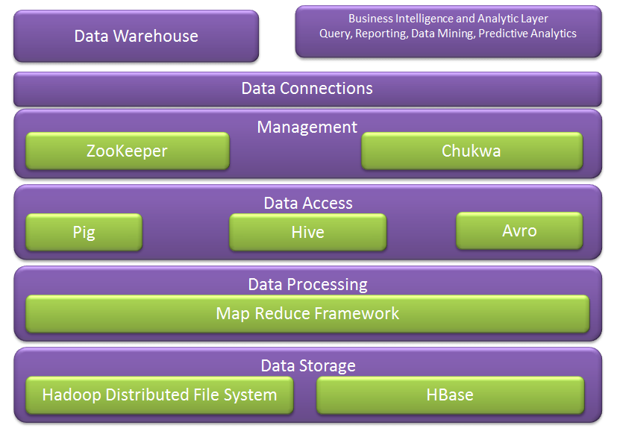
Hadoop Ecosystem
Next week we cover more of these
We covered these

Slide 3
Query Languages for Hadoop
Java: Hadoop’s Native Language
Pig: Query and Workflow Language
Hive: SQL-Based Language
HBase: Column-oriented Database for MapReduce

Slide 4

Java is Hadoop’s Native Language
Hadoop itself is written in Java
Provided Java APIs
For mappers, reducers, combiners, partitioners
Input and output formats
Other languages, e.g., Pig or Hive, convert their queries to Java MapReduce code

Slide 5
Levels of Abstraction
Less Hadoop
visible
HBase
Queries against tables
More DB view
Hive
SQL-Like language
Pig
Query and workflow language
Java
Write map-reduce functions
More Hadoop
visible
More map-reduce view

Slide 6
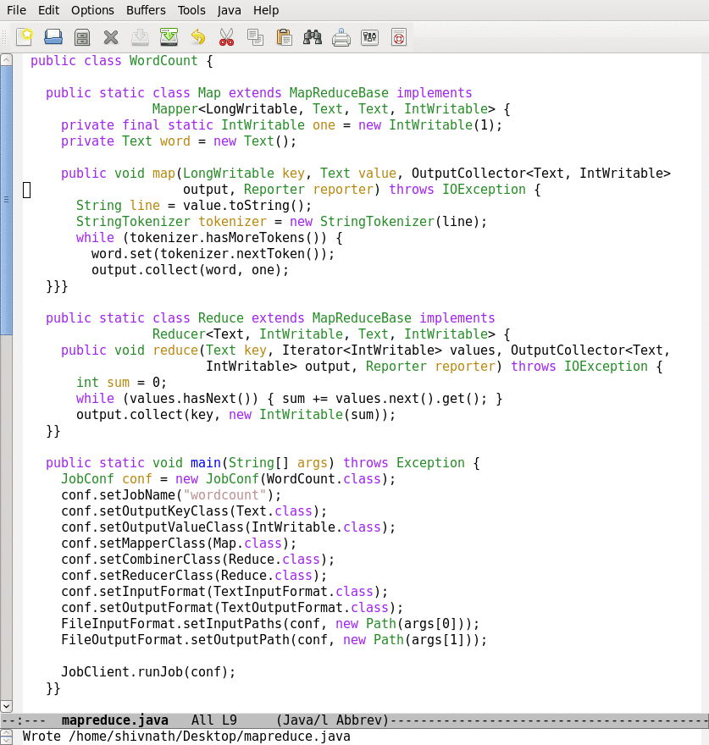
Java Example
map
reduce
Job conf.

Slide 7
Apache Pig

Slide 8

What is Apache Pig
A platform for analyzing large data sets that consists of a high-level language for expressing data analysis programs.
Compiles down to MapReduce jobs
Developed by Yahoo!
Open-source language

Slide 9
High-Level Language
raw = LOAD 'excite.log' USING PigStorage('\t') AS (user, id, time, query);
clean1 = FILTER raw BY id > 20 AND id < 100;
clean2 = FOREACH clean1 GENERATE
user, time,
org.apache.pig.tutorial.sanitze(query) as query;
user_groups = GROUP clean2 BY (user, query);
user_query_counts = FOREACH user_groups
GENERATE group, COUNT(clean2), MIN(clean2.time), MAX(clean2.time);
STORE user_query_counts INTO 'uq_counts.csv' USING PigStorage(',');

Slide 10
Pig Components
High-level language (Pig Latin)
Set of commands
Two Main Components
Two execution modes
Local: reads/write to local file system
Mapreduce: connects to Hadoop cluster and reads/writes to HDFS
Interactive mode
Console
Two modes
Batch mode
Submit a script

Slide 11
Why Pig?...Abstraction!
Common design patterns as key words (joins, distinct, counts)
Data flow analysis
A script can map to multiple map-reduce jobs
Avoids Java-level errors (not everyone can write java code)
Can be interactive mode
Issue commands and get results

Slide 12
Example I: More Details
Read file from HDFS
The input format (text, tab delimited)
Define run-time schema
raw = LOAD 'excite.log' USING PigStorage('\t') AS (user, id, time, query);
clean1 = FILTER raw BY id > 20 AND id < 100;
clean2 = FOREACH clean1 GENERATE
user, time,
org.apache.pig.tutorial.sanitze(query) as query;
user_groups = GROUP clean2 BY (user, query);
user_query_counts = FOREACH user_groups
GENERATE group, COUNT(clean2), MIN(clean2.time), MAX(clean2.time);
STORE user_query_counts INTO 'uq_counts.csv' USING PigStorage(',');
Filter the rows on predicates
For each row, do some transformation
Grouping of records
Compute aggregation for each group
Store the output in a file
Text, Comma delimited

Slide 13
Pig: Language Features
Keywords
Load, Filter, Foreach Generate, Group By, Store, Join, Distinct, Order By, …
Aggregations
Count, Avg, Sum, Max, Min
Schema
Defines at query-time not when files are loaded
UDFs
Packages for common input/output formats

Slide 14
Example 2
Script can take arguments
Data are “ctrl-A” delimited
Define types of the columns
A = load '$widerow' using PigStorage('\u0001') as (name: chararray, c0: int, c1: int, c2: int);
B = group A by name parallel 10;
C = foreach B generate group, SUM(A.c0) as c0, SUM(A.c1) as c1, AVG(A.c2) as c2;
D = filter C by c0 > 100 and c1 > 100 and c2 > 100;
store D into '$out';
Specify the need of 10 reduce tasks

Slide 15
Example 3: Re-partition Join
Register UDFs & custom inputformats
Function the jar file to read the input file
register pigperf.jar;
A = load ‘page_views' using org.apache.pig.test.udf.storefunc.PigPerformanceLoader()
as (user, action, timespent, query_term, timestamp, estimated_revenue);
B = foreach A generate user, (double) estimated_revenue;
alpha = load ’users' using PigStorage('\u0001') as (name, phone, address, city, state, zip);
beta = foreach alpha generate name, city;
C = join beta by name, B by user parallel 40;
D = group C by $0;
E = foreach D generate group, SUM(C.estimated_revenue);
store E into 'L3out';
Load the second file
Join the two datasets (40 reducers)
Group after the join (can reference columns by position)
This grouping can be done in the same map-reduce job because it is on the same key (Pig can do this optimization)

Slide 16
Example 4: Replicated Join
register pigperf.jar;
A = load ‘page_views' using org.apache.pig.test.udf.storefunc.PigPerformanceLoader()
as (user, action, timespent, query_term, timestamp, estimated_revenue);
Big = foreach A generate user, (double) estimated_revenue;
alpha = load ’users' using PigStorage('\u0001') as (name, phone, address, city, state, zip);
small = foreach alpha generate name, city;
C = join Big by user, small by name using ‘replicated’;
store C into ‘out';
Map-only join (the small dataset is the second)
Optimization in joining a big dataset with a small one

Slide 17
Example 5: Multiple Outputs
A = LOAD 'data' AS (f1:int,f2:int,f3:int);
DUMP A;
(1,2,3)
(4,5,6)
(7,8,9)
SPLIT A INTO X IF f1<7, Y IF f2==5, Z IF (f3<6 OR f3>6);
DUMP X;
(1,2,3)
(4,5,6)
DUMP Y;
(4,5,6)
STORE x INTO 'x_out';
STORE y INTO 'y_out';
STORE z INTO 'z_out';
Split the records into sets
Dump command to display the data
Store multiple outputs

Slide 18
Run independent jobs in parallel
D1 = load 'data1' …
D2 = load 'data2' …
D3 = load 'data3' …
C1 = join D1 by a, D2 by b
C2 = join D1 by c, D3 by d
C1 and C2 are two independent jobs that can run in parallel

Slide 19
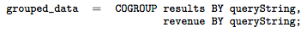
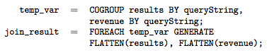
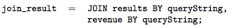
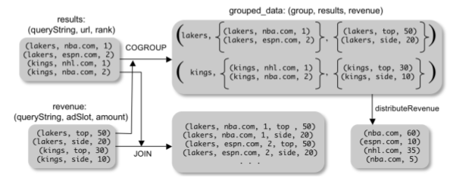
Pig Latin: CoGroup
Combination of join and group by
Make use of Pig nested structure

Slide 20
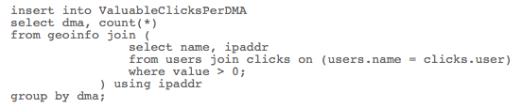
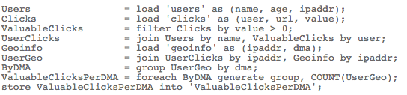
Pig Latin vs. SQL
Pig Latin is procedural (dataflow programming model)
Step-by-step query style is much cleaner and easier to write
SQL is declarative but not step-by-step style
SQL
Pig
Latin

Slide 21
Pig Latin vs. SQL
In Pig Latin
Lazy evaluation (data not processed prior to STORE command)
Data can be stored at any point during the pipeline
Schema and data types are lazily defined at run-time
An execution plan can be explicitly defined
Use optimizer hints
Due to the lack of complex optimizers
In SQL:
Query plans are solely decided by the system
Data cannot be stored in the middle
Schema and data types are defined at the creation time

Slide 22
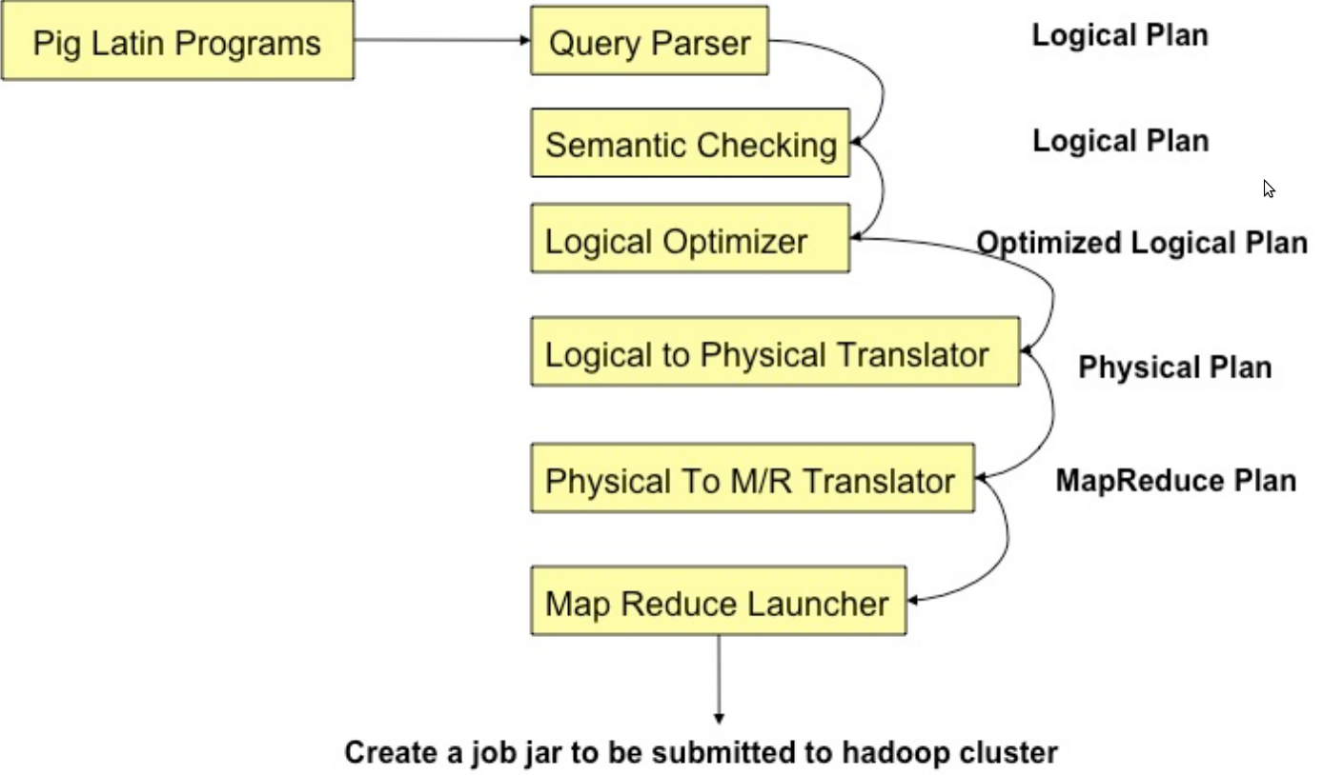
Pig Compilation

Slide 23
Logic Plan
A=LOAD 'file1' AS (x, y, z);
B=LOAD 'file2' AS (t, u, v);
C=FILTER A by y > 0;
D=JOIN C BY x, B BY u;
E=GROUP D BY z;
F=FOREACH E GENERATE group, COUNT(D);
STORE F INTO 'output';
LOAD
LOAD
FILTER
JOIN
GROUP
FOREACH
STORE

Slide 24
Physical Plan
1:1 correspondence with the logical plan
Except for:
Join, Distinct, (Co)Group, Order
Several optimizations are done automatically

Slide 25
Generation of Physical Plans
If the Join and Group By are on the same key ➔ The two map-reduce jobs would be merged into one.

Slide 26
Java vs. Pig
Performance is comparable (Java is slightly better)

Slide 27
Pig References
Pig Tutorial
http://pig.apache.org/docs/r0.7.0/tutorial.html
Pig Latin Reference Manual 2
http://pig.apache.org/docs/r0.7.0/piglatin_ref1.html
Pig Latin Reference Manual 2
http://pig.apache.org/docs/r0.7.0/piglatin_ref2.html
PigMix Queries
https://hpccsystems.com/why-hpcc-systems/benchmarks/pigmix-hpcc

Slide 28

Apache Pig

